Slide 1
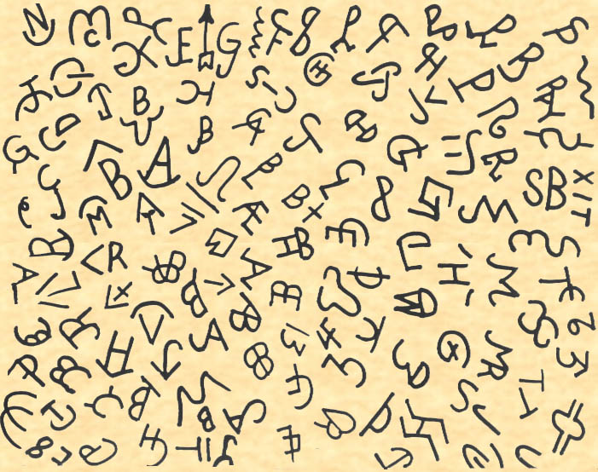
Texas Brand Re-registration TSCRA Law Enforcement

Slide 2
Agenda
About TSCRA
Brands in Texas
Facts and Figures
Ag Code
Brand Registration
Recording Brands
Submitting Brand Records
Questions

Slide 3
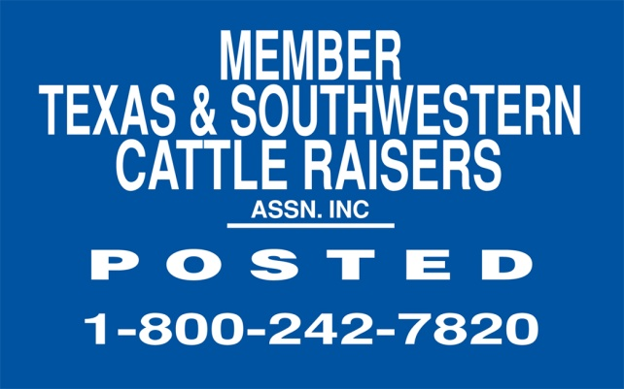
About TSCRA
Founded in 1877
Largest livestock association in Texas
What we provide:
Law Enforcement
Legislative Voice
Insurance
Exclusive News and Information
Educational Programs

Slide 4
About TSCRA Law Enforcement
TSCRA Special Rangers are peace officers
Commissioned by the Texas Department of Public Safety and/or Oklahoma Bureau of Investigation with statewide authority
All have extensive law enforcement and livestock background
Annually recover or account for an average of $5,000,000 in livestock and property

Slide 5
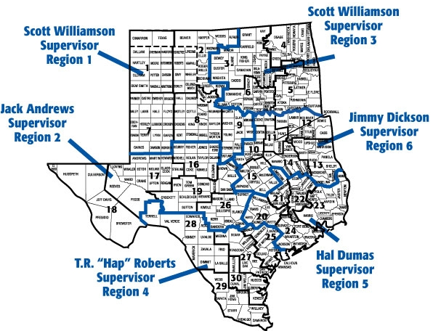
About TSCRA Law Enforcement
TSCRA Districts and Regions:

Slide 6
Brands in Texas
Did you know…
The Texas livestock industry accounts for over $7 billion in total receipts
There are currently over 13.3 million cattle and 1 millions horses in Texas
There are currently 102,000 registered brands in Texas

Slide 7
Brands in Texas
Section 144.041 of the Texas Agriculture Code addresses recording of marks and brands:
§ 144.041. MARKS AND BRANDS TO BE RECORDED. (a) Each person who owns cattle, hogs, sheep, or goats shall record that person's earmarks, brands, tattoos, and electronic devices with the county clerk of the county in which the animals are located.
(b) A person who owns a horse shall record an identification mark authorized by Section 144.001(b) with the county clerk of the county in which the animal is located.

Slide 8
Brands in Texas
Section 144.041 cont’d:
(c) The county clerk shall keep a record of the marks and brands of each person who applies to the clerk for that purpose.
(d) A person may record that person's marks and brands in as many counties as necessary.
(e) A person may record any mark or brand that the person desires to use if no other person has recorded the mark or brand, without regard to whether that person has previously recorded a mark or brand.

Slide 9
Brands in Texas
Section 144.041 cont’d:
(f) Not later than the 30th day after the date a county clerk receives a record relating to cattle or horses under this section, the clerk shall forward a copy of the record to the association authorized to inspect livestock under 7 U.S.C. Section 217a (Texas and Southwestern Cattle Raisers Association).

Slide 10
Brand Registration
What:
All brands must be re-registered every 10 years
New brands can be registered at anytime
When:
Re-registration period is Aug. 31, 2011 – Feb. 29, 2012
A person who does not re-register their brand during this 6 month period, forfeits their legal right to that brand

Slide 11
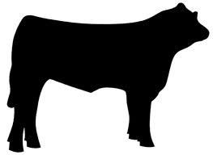
Brand Registration
Where on the animal:
The brand location is as important as the brand itself
The same brand may be registered in the same county as long as the location on the animal is different. Shown below, these are considered two distinct markings:
-LG
-LG

Slide 12
Brand Registration
Similar Brands:
If a party comes in to register a brand which the clerk feels is too similar to a brand currently registered, the clerk has the right/authority to refuse to register that brand. It’s the clerks duty to make sure duplicate brands are not registered in same location on an animal.
-LG
-LC

Slide 13
Brand Registration
Brand Transfer:
Brands may be transferred.
This requires a notarized affidavit signed by the current brand holder which relinquishes title of the brand to the transferee.
Brand transfers must be sent to TSCRA.

Slide 14
Brand Registration
Fees:
County Clerks may charge for registering brands and marks.
The County Clerk may charge the same fee for brand transfers as for registering a new brand.

Slide 15
Brand Registration
How are brand records used?:
In criminal investigations by law enforcement on local, state, and federal level
Texas Animal Health Commission and USDA-APHIS for animal disease traceback
Agricultural lending institutions use brands to secure livestock loans

Slide 16
Brand Registration
How are brand records used?:
By county sheriff offices to determine ownership of estray livestock
Judges and attorneys reference brands in many types of civil litigations involving livestock
County Clerks often receive a subpoena to testify in court as to the accuracy of their brand registration procedure

Slide 17
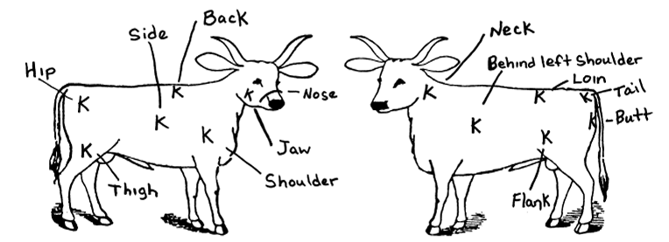
Recording Brands
Records are comprised of a mark and location
Location:
Left or right: shoulder, side, rib, flank, hip, loin, or thigh
Jaw, face, tail, back, leg, or nose

Slide 18
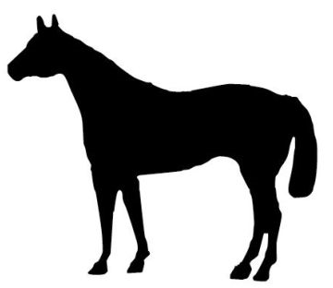
Recording Brands
Location (cont’d):
Sometimes, multiple locations may be used for one record:
X
-L
7

Slide 19
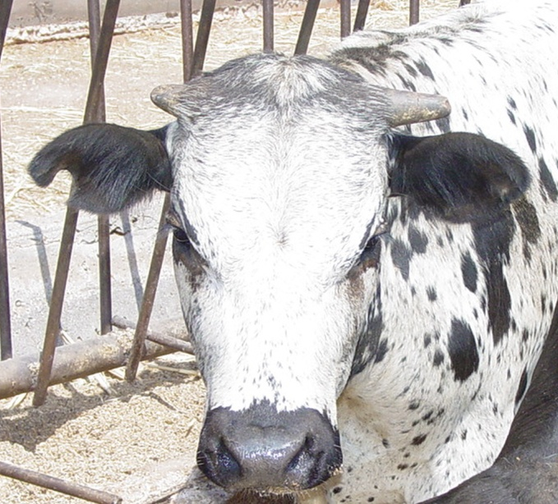
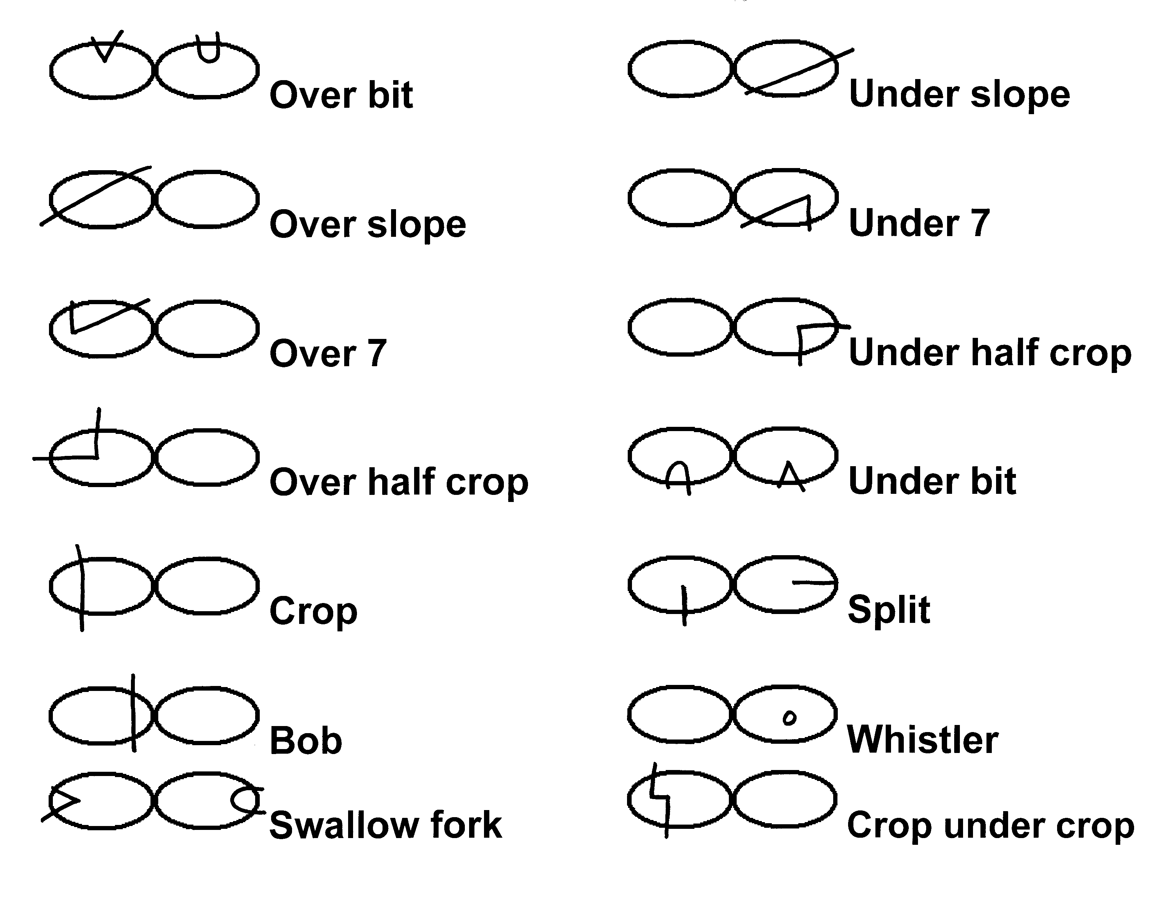
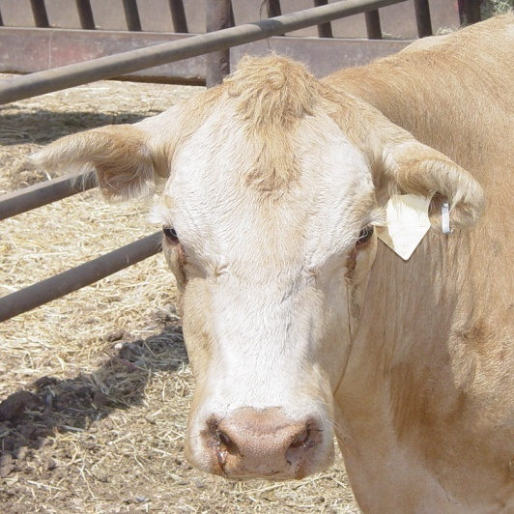
Recording Brands
Ear marks may also be used
Each mark must be designated right or left and registered with the brand

Slide 20
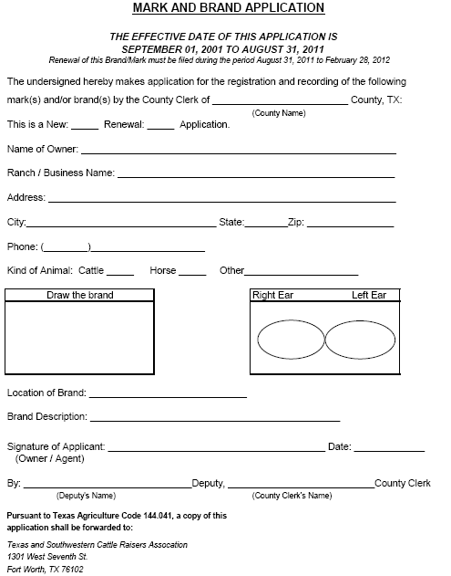
Recording Brands
TSCRA provides a Mark and Brand Applications which may be used to register brands
These forms replace the smaller cards which were used in previous brand registrations
The application is available by calling TSCRA at 800-242-7820

Slide 21
Recording Brands
TSCRA stores these records electronically.
Records may be searched by name, county, brand or other criteria.
Through TSCRA, County Clerks will also have access to a searchable brand database

Slide 22
Submitting Brand Records
Records may be sent to TSCRA several ways:
Email scanned forms to brands@tscra.org
Fax forms to 817-887-4402
Mail to TSCRA offices
Electronic Records - For more information, contact TSCRA.
Some software providers now offer Automated Transfer of brand records to TSCRA. For more information, contact TSCRA or your service provider.

Slide 23
Submitting Brand Records
What if the owner passes away and the heir wants to register the brand?
The heir must provide proof of will or family agreement along with death certificate.
Can a minor have a registered brand?
Yes, however, the proper use of a brand is the parent/guardian’s responsibility.

Slide 24
Submitting Brand Records
How often should I send in the brand registrations?
You may submit brands daily or weekly, but no later than 30 days from the time registered.
How do I handle a dispute over the rightful owner of a brand?
The party who has registered or used the brand the longest has ownership of the brand.

Slide 25
Contacts
Larry Gray
Executive Director, Law Enforcement and Theft Prevention Services
817-332-7064, ext. 112
lgray@tscra.org
Marie McMillan
Brand Department
817-332-7064, ext. 115
mmcmillan@tscra.org
www.tscra.org

Slide 26
Questions?

